Slide 1
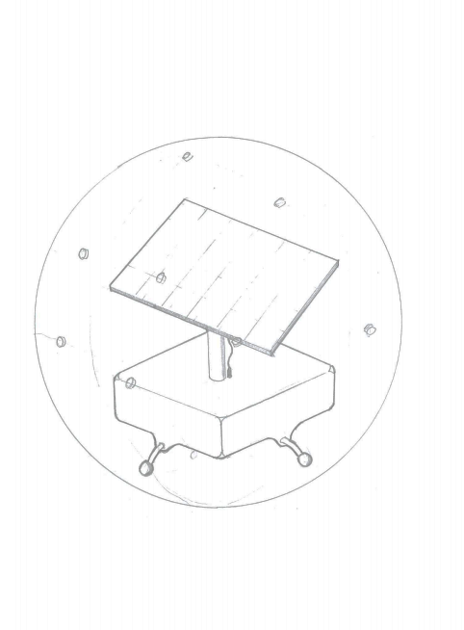
transparent, 2 part perforated hemispheres
Solar Panel
Electronics enclosure
Universal transfer bearings

